Slide 1
Water Intake Observations
Nick Dillner
November 2023

Slide 2

Question:
What affects the amount of water I drink in a day?
Is the amount of water I drink dependent on whether I am working from home or in the office?

Slide 3
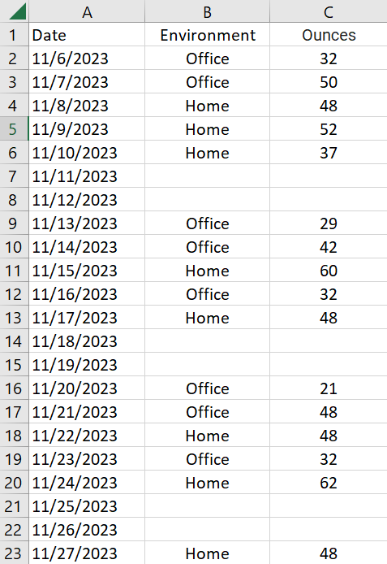
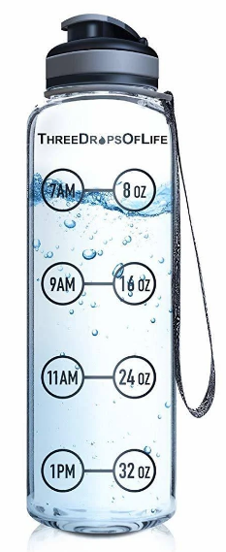
Observations:
Data:
Variables:
Environment:
Home or Office
Ounces of water drank:
Used a water bottle to
track the # of ounces
16 total observations
8 at home samples
8 in office samples
Tools:

Slide 4
Hypothesis
Claim:
The mean number of ounces drank on days where I worked from home is significantly greater than the mean number of ounces drank when working in the office.
Dependent Variable:
Ounces of water
Independent Variable:
Environment
Null Hypothesis (H0):
μ1 <= μ2
Alternative Hypothesis (H1):
μ1 > μ2
Key:
μ1 = Mean Home
μ2 = Mean Office

Slide 5
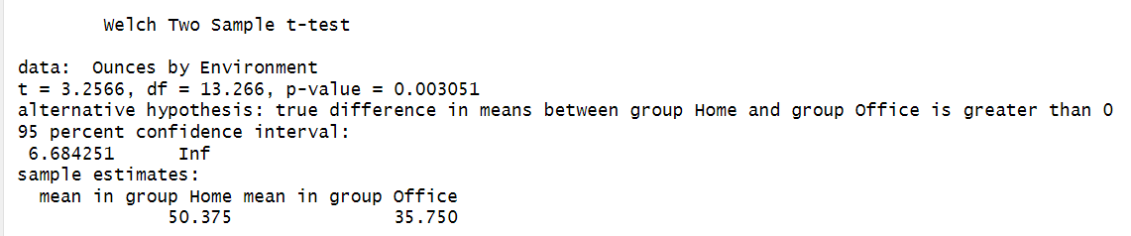
T-Test
Test Statistic:
T = 3.2566
P-Value = 0.003051
Mean:
Home = 50.375
Office = 35.750
Confidence:
Significance level = 0.05
If P-Value < 0.05, we reject the null hypothesis

Slide 6
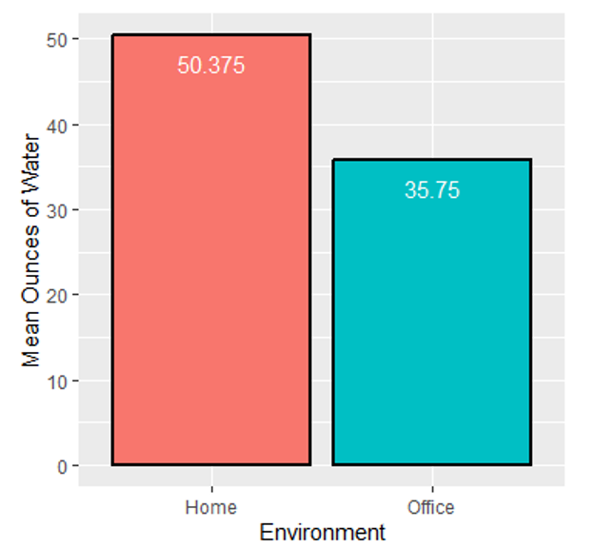
Conclusion
P-Value < Significance level
0.003051 < 0.05
Since the p-value 0.003051 is less than 0.05, we reject the null hypothesis.
We have enough evidence to conclude that the mean number of ounces drank on days where I worked from home is significantly greater than the mean number of ounces drank when working in the office.

Slide 7
Questions?

Slide 8
GitHub Repository https://github.com/NickDillner/Data211

